Slide 1

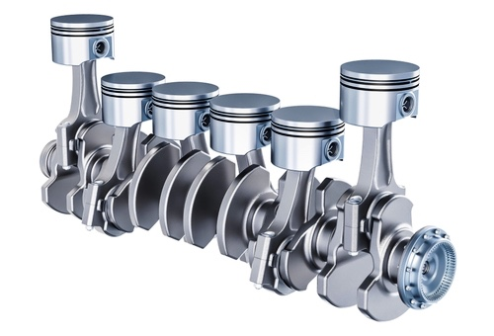

Cylinder Performance
Do 6 Cylinders get better Gas Mileage ?

Slide 3
Mileage Difference versus 6 and 8 cylinders is significant.
With 95% confidence we can conclude mileage is between 3.31mpg and 3.45mpg more.

Slide 5
Mileage Difference versus 6 and 10 cylinder is significant.
With 95% confidence we can conclude mileage is between 4.34mpg and 4.94mpg more.

Slide 6
Cylinder Comparison Miles Per Gallon

Slide 7

Conclusion
6 CYLINDER ENGINES SIGNIFICANTLY HAVE BETTER GAS MILAGE THAN LARGER CYLINDER CARS.
THEREFORE LESS GAS COMSUMPTION AND LESS MONEY SPENT OF FUEL.

